Slide 1
System Training
For Investment and Industry Office

Slide 2
Qabxiiwwan Ijoo
Seensa
Gahee fi Itti Gaafatamummaa Fayyadamtootaa
Amaloota Ijoo Sirnichaa
Adeemsa Hojii Sirnaa
Agarsiisa

Slide 3
Introduction
Systems
E-service
Inter Office Communication
IDMS

Slide 4
e-service
E-Service system is designed to streamline the management of investment and industry services by enabling online transactions, efficient service delivery, and improved interaction between applicants, officers, leaders, and administrators.
The training is structured to provide tailored instructions to various system users, including Agents for Applicants (users), Officers, Leaders, and Administrators. Each user group will receive specialized training according to their responsibilities and system interactions.

Slide 5
e-service
User Roles and Responsibilities
Applicants:
Submit applications.
Track application status.
Respond to officer queries.
Officers:
Review applications.
Request additional information.
Approve or forward applications.
Leaders:
Monitor system performance.
Oversee application approvals.
Generate reports for decision-making.
Admins:
Manage system settings.
Assign roles and permissions.
Handle technical issues.

Slide 6
e-service
Key Features of the System
User Dashboard
Application Submission:
Notifications:
Reports and Analytics:
Multi-Level Access.

Slide 7
e-service
Application Workflow
Step 1
Applicant submits an online form.
Step 2
Officer reviews and provides feedback or requests clarifications.
Step 3
Officer approves or escalates to leaders for higher-level approval.
Step 4
Leader approves or rejects the application.
Step 5:
Notification sent to the applicant with the decision.

Slide 8
e-service
Demonstration
Applicant Role:
Walkthrough: Registration, submitting an application, tracking status.
Officer Role:
Walkthrough: Reviewing an application, adding comments, and approvals.
Leader Role:
Walkthrough: Monitoring applications, generating reports.
Admin Role:
Walkthrough: Managing users, troubleshooting.

Slide 9
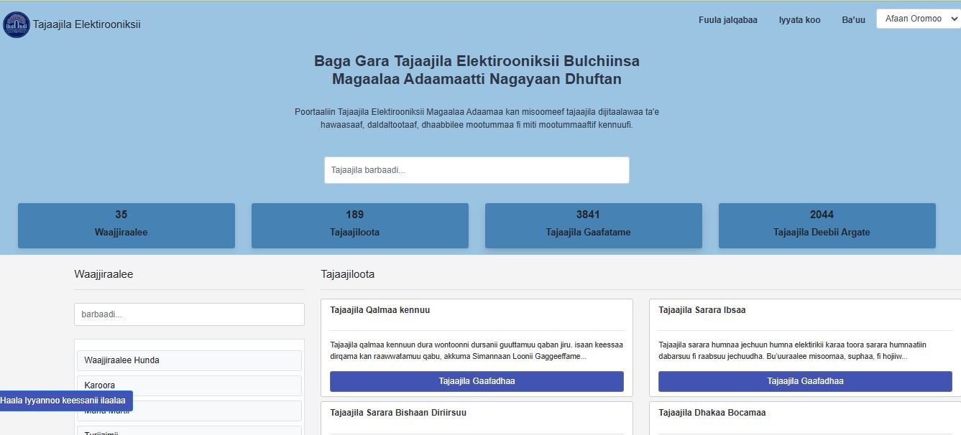
Cont..

Slide 10
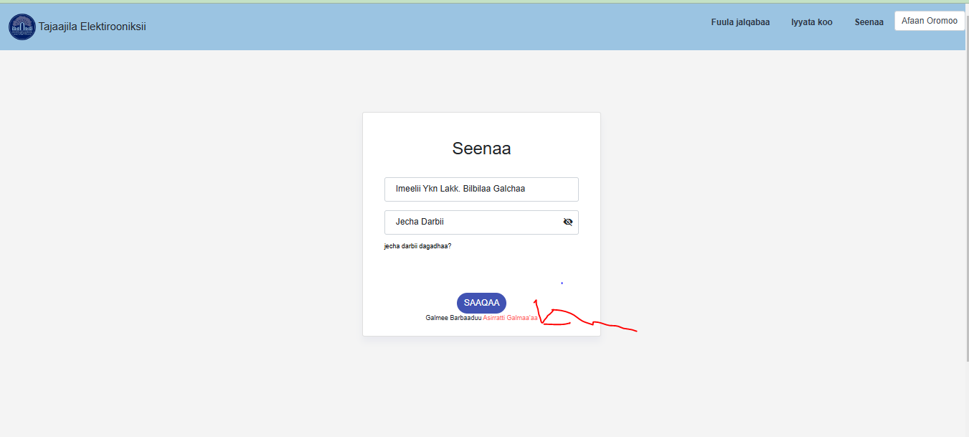
Cont..

Slide 11
THANK YOU!!
https://eservice.adamacity.gov.et/

Slide 12
Gola Adama/inter office communication
Introduction to the Inter-Office Communication System
Benefits of a Unified Communication System
Features of the System
Roles and Responsibilities
Communication Workflow Across Offices

Slide 13
Gola Adama/inter office communication
Introduction to the Communication System
Purpose:
Enhance communication between 32 offices in Adama.
Streamline workflows, task assignments, and information sharing.
Minimize delays caused by traditional communication methods.
Scope:
Facilitate coordination for shared projects, approvals, and escalations.
Ensure transparency and accountability in communication

Slide 14
Cont.…..
Benefits of a Unified Communication System
Efficiency:
Reduce time spent on physical document transfers.
Real-time updates for urgent matters.
Transparency:
All communication is logged and traceable.
Collaboration:
Easy information sharing across offices.
Accountability:
Role-based tracking ensures tasks are completed by the right personnel.

Slide 15
Cont.…
Features of the System
Internal Messaging:
Instant messaging between offices or specific roles.
Task Management:
Assign tasks with deadlines and monitor progress.
Document Sharing:
Upload, share, and collaboratively access documents.
Notifications:
Automatic alerts for updates, approvals, or task reminders.
Centralized Dashboard:
Office-wise and role-specific views for better tracking.

Slide 16
Cont.…
Features of the System
Internal Messaging:
Instant messaging between offices or specific roles.
Task Management:
Assign tasks with deadlines and monitor progress.
Document Sharing:
Upload, share, and collaboratively access documents.
Notifications:
Automatic alerts for updates, approvals, or task reminders.
Centralized Dashboard:
Office-wise and role-specific views for better tracking.

Slide 17
Cont.…
Roles and Responsibilities
Department Heads:
Oversee inter-office communication for their departments.
Approve escalations and monitor workflows.
Communication Officers:
Manage day-to-day correspondence with other offices.
Respond to and forward tasks.
Admins:
Manage user accounts, permissions, and system settings.

Slide 18
Cont.…
Communication Workflow Across Offices
Step 1: Request or task is initiated by one office.
Step 2: Request is routed to the relevant department or role.
Step 3: Task is reviewed, updated, or completed by the assigned office.
Step 4: Response or feedback is sent to the requesting office.
Step 5: Notifications are sent to all relevant parties.

Slide 19
THANK YOU!!
https://gola.adamacity.gov.et/

Slide 20
IDMS
IDMS

Slide 21
IDMS
Introduction to IDMS
What is IDMS?A centralized platform for creating, sharing, storing, and managing documents.
Designed to support 32 interconnected offices in Adama.
Purpose:Improve document handling efficiency.
Facilitate seamless collaboration and access control.
Reduce dependency on physical paperwork.

Slide 22
IDMS
Benefits of IDMS for Adama Offices
Centralized Storage:
Access documents from a unified repository.
Real-Time Collaboration:
Edit and comment on documents simultaneously.
Access Control:
Role-based permissions to ensure security.
Version Control:
Track and revert to previous versions if needed.
Time Efficiency:
Reduce delays caused by manual processes and document transfers.

Slide 23
IDMS
Features of the System
Document Upload & Organization:
Simple folder structures for storing and categorizing files.
Search & Retrieval:
Advanced search filters (by name, tags, date, or author).
Collaboration Tools:
Commenting, editing, and approval workflows.
Access Permissions:
Assign read/write or admin rights based on roles.
Notifications:
Alerts for document updates or shared files.
Integration:
Compatible with email and inter-office communication systems.

Slide 24
IDMS
Roles and Responsibilities
Document Creators:
Create, upload, and categorize documents.
Reviewers/Approvers:
Review, approve, or reject document submissions.
Users:
Access shared documents, download, or view as per permissions.
System Admins:
Manage user roles, access controls, and system settings.

Slide 25
THANK YOU!!
https://dms.adamacity.gov.et/

